Slide 1
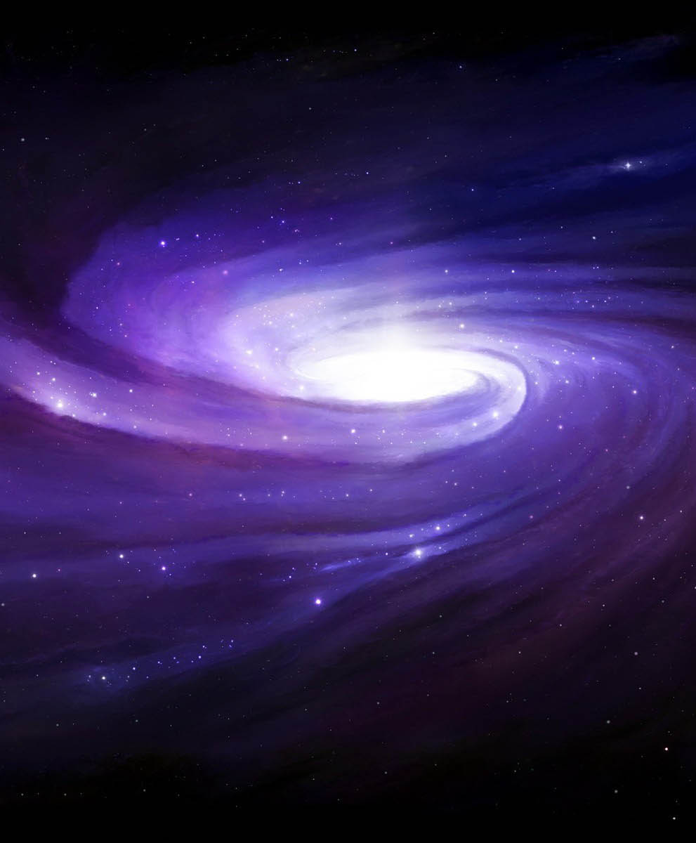

Signatures of Traversable Wormholes
Sadie Cullings
Mentor: Paul Davies
Arizona State University
School for Engineering of Matter, Transport, and Energy / Physics Department, Beyond Center
Arizona NASA Space Grant Statewide Symposium (AZSGC)
April 22, 2023
This Photo by Unknown author is licensed under CC BY.

Slide 2
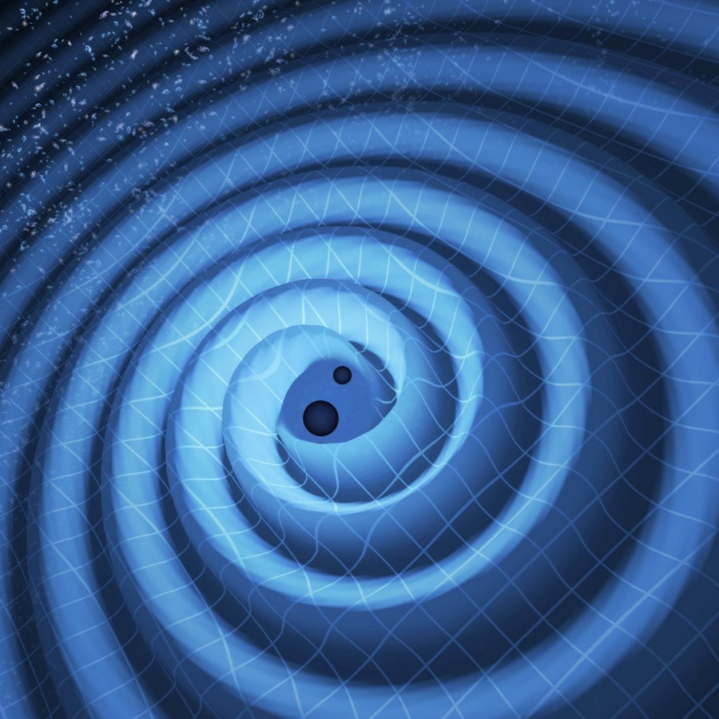
Gravitational Waves
Ripples in the fabric of space and time
Can be detected through LIGO (Laser Interferometer Gravitational-Wave Observatory) and other similar facilities such as Virgo
This Photo by Unknown author is licensed under CC BY-SA-NC.

Slide 3
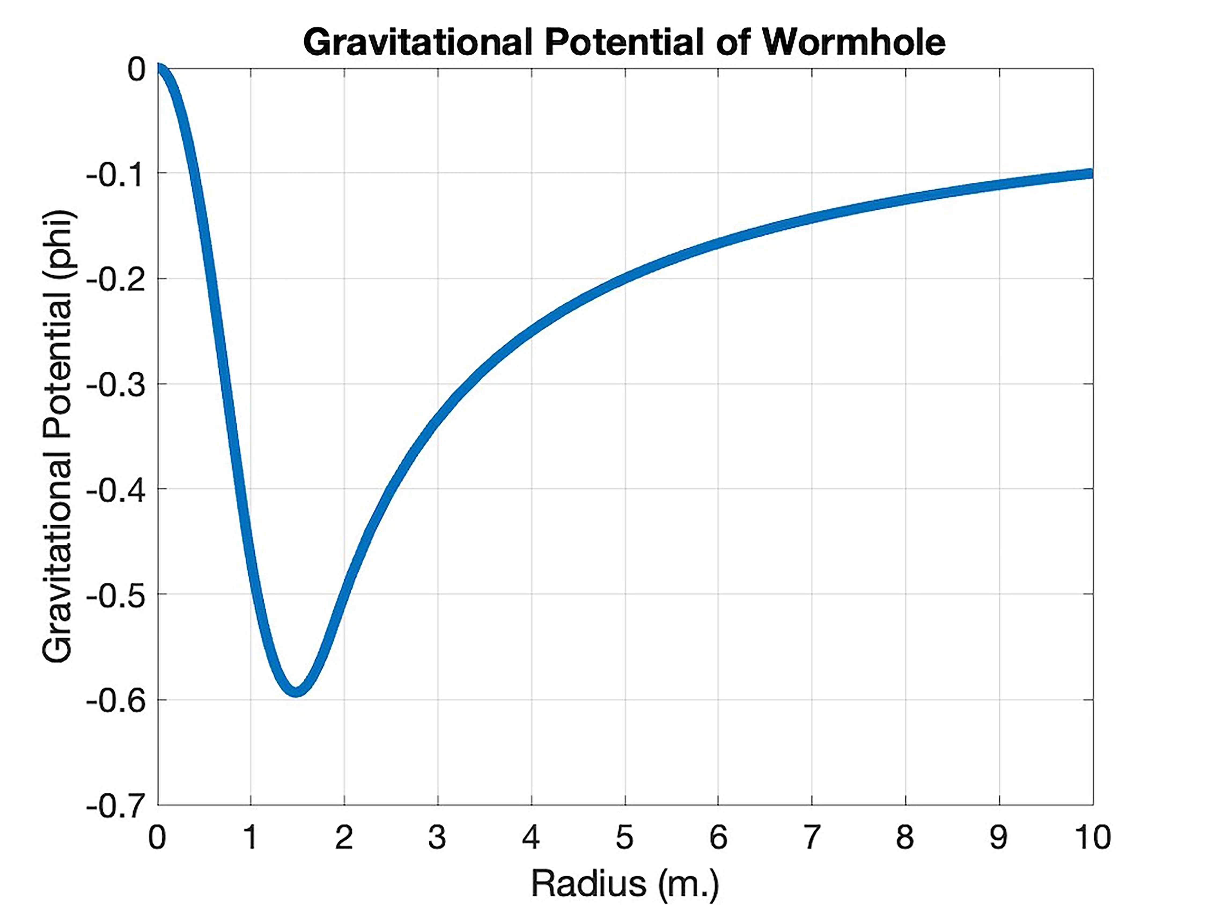
Gravitational Potential Figure
Assumptions:
Spherically symmetric
Smoothly, varying mass-density distribution
Inner region of negative mass-density
Outer region of positive mass-density

Slide 4
Research Project Overview
Goals:
Identify Gravitational-Wave Signatures that would give evidence of the existence of traversable wormholes
Accomplishments:
Created the first Newtonian analogue of a traversable wormhole using Poisson's equation
Determined how in-falling objects would behave depending on a variety of factors, such as speed
Evaluated how these behaviors would create specific gravitational wave signatures

Slide 5
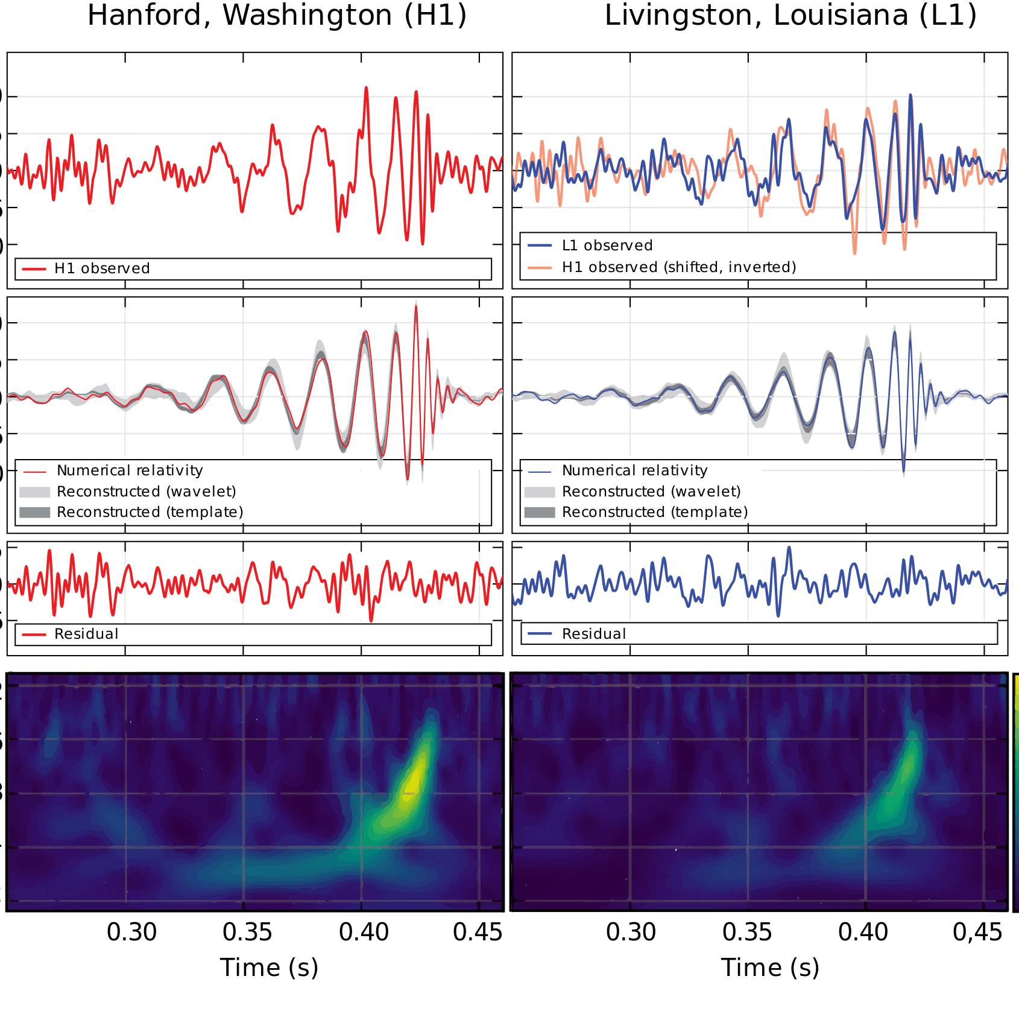
Next Steps
Explore and identify different models of traversable wormholes
Use General/Special Relativity & Quantum Mechanics for more exact signature
Compare Gravitational Wave Signature Identified to current signatures detected by LIGO (Laser Interferometer Gravitational Wave Observatory) or other facilities of other astrophysical phenomena such as Binary Black Hole Collisions)
This Photo by Unknown author is licensed under CC BY-SA.

Slide 6
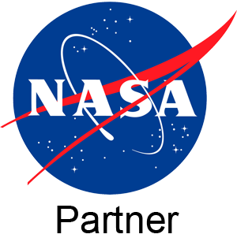
Thank you!
"Supported in part through the Arizona NASA Space Grant Consortium, Cooperative Agreement 80NSSC20M0041."

